Slide 1

Twitter Sentiment Analysis
Brand Monitoring
by Boula Akladyous

Slide 2
Brand Monitoring
Project Outline
Background
Problem Statement
Business Value
Methodology
Exploratory Data Analysis
Classification and Effectiveness
Results

Slide 3
Brand Monitoring
Background
Brand monitoring is a business process of tracking different channels to strategically monitor the reputation, growth and topics associated with a brand. It's also great for getting info on how your products are viewed and talked about.
Brand monitoring benefits:
Brand monitoring can help you identify how your brand is being spoken about.
Spot negative sentiment surrounding your brand or plagiarism or rights infringements being made.
Use insights about how your brand is perceived to aid development of new product, services or goods
Gain knowledge about how both your brand and competitor brands are being perceived on different platforms.
Understand the audience discussing both your brand and category to plan marketing and communication strategies

Slide 4
Brand Monitoring
Problem Statement
Provide a statistical analysis on tracking consumer sentiment and funneling the collected information towards building more effective and meaningful strategy
Classification model to gain meaningful insights into consumer preferences and brand sentiment

Slide 5
Brand Monitoring
Business Value
Learn about customer sentiment to better understand your audience and what they’re saying on Twitter
Evaluate Overall Public Perception of Your Brand
Reputation management and online brand monitoring

Slide 6
Brand Monitoring
Methodology
Data Management
Data Collection
Data Scrubbing
Feature Engineering
Exploratory Data Analysis
Modeling
Model Building
Model Evaluation

Slide 7
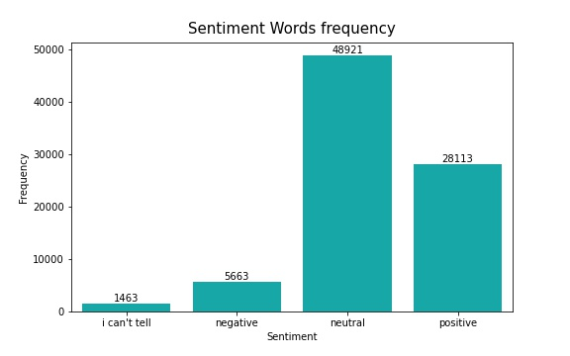
Exploratory Data Analysis

Slide 8
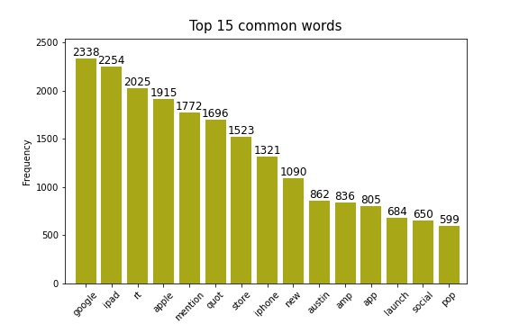
Exploratory Data Analysis

Slide 9
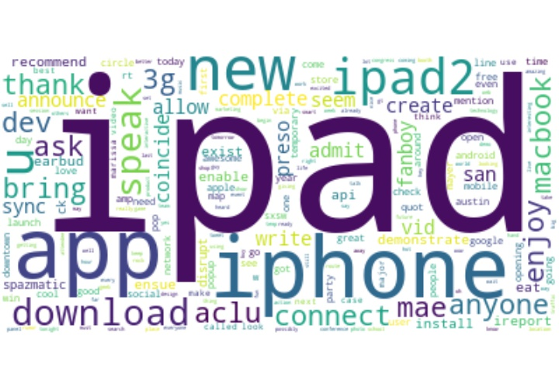
Exploratory Data Analysis
Common Positive Words

Slide 10
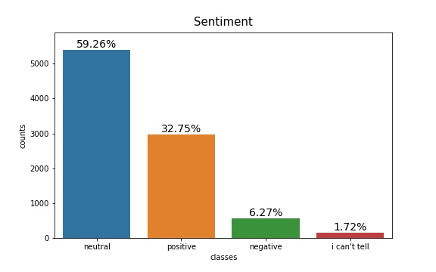
Brand Monitoring
Conclusion
For the first model we used a simple Deep Neural Network with TF-IDF Vectorizer which results 87% of AUC accuracy but didn't able to predict more than 2 classes.
The GloVe Embedding model constructed with Recurrent Neural Networks got less performance with 82% AUC accuracy.
The overall result is not so much bad, dealing with a highly. imbalanced dataset where the class distributions are respectively represented by 59.26%, 32.75% 6.27% and 1.72%, ML models wouldn't be able to learn. essentially we would need to have sufficiently large data to get better results.

Slide 11
Brand Monitoring
Recommendation
Gather more data covering different social platforms from various sources like Facebook, Twitter, Instagram, YouTube etc..
Monitor live feedback
Monitor specific demographics

Slide 12
Brand Monitoring
Future Work
Develop multi-source web scraping.
Improve technical analysis by incorporating new features like
Number of mentions
Brand mentions
Users geographic area
Types and number of interactions

Slide 13
Thank you
By Boula Akladyous
Email akladyous@gmail.com
Github https://github.com/akladyous/Twitter-sentiment-Analysis

